Slide 1




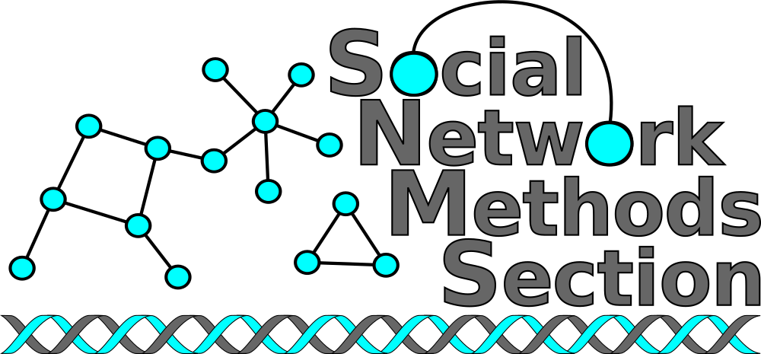
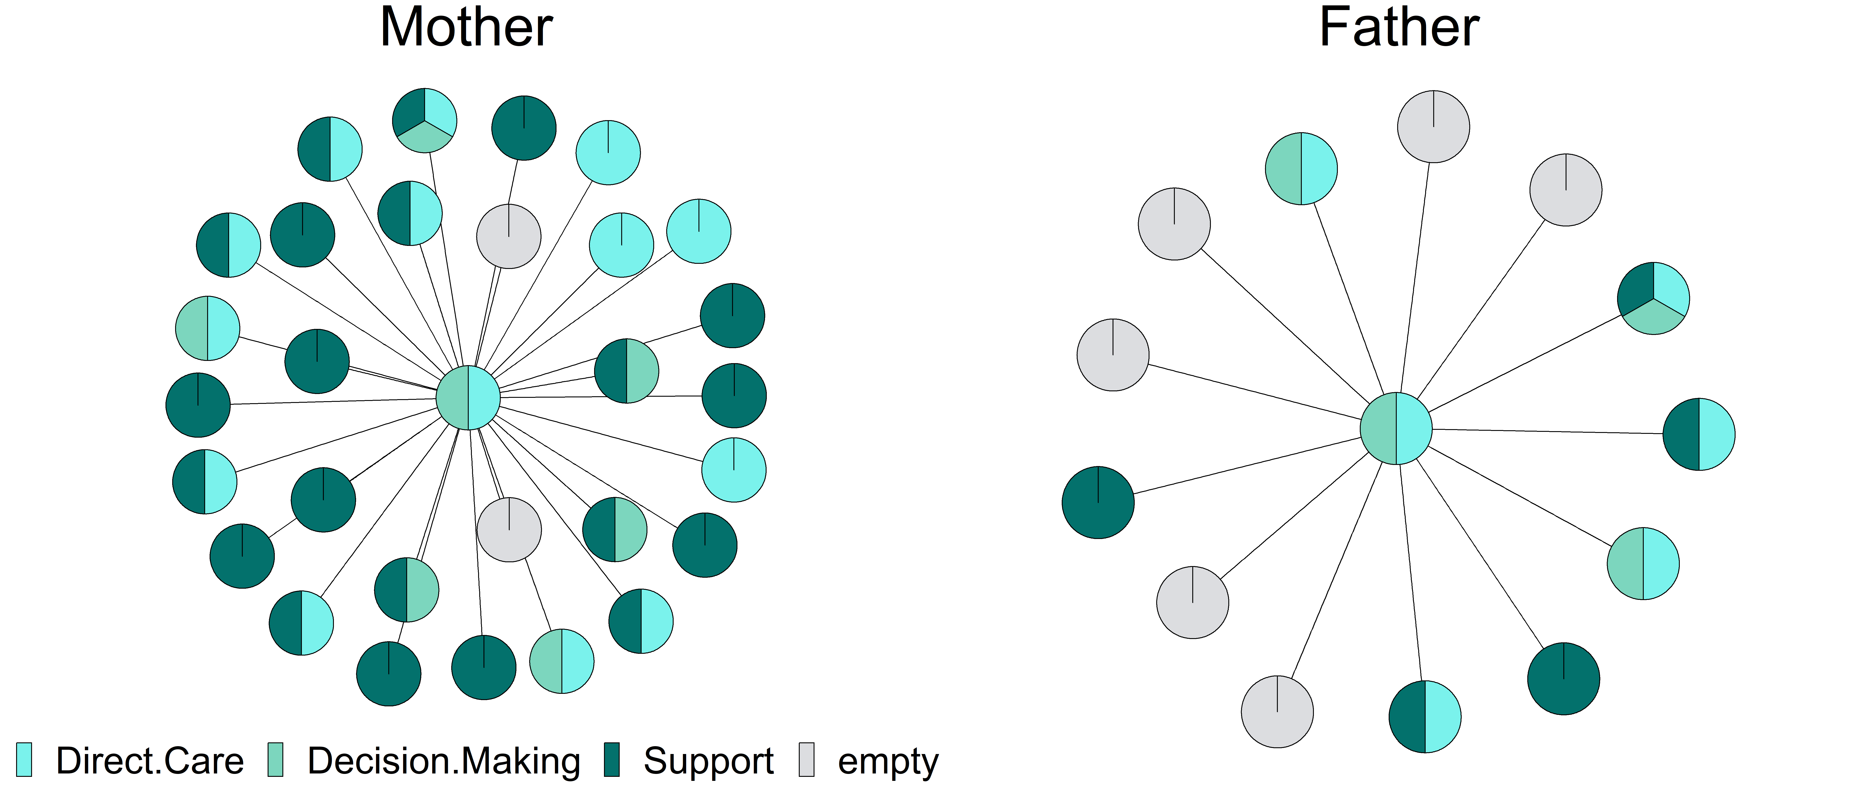
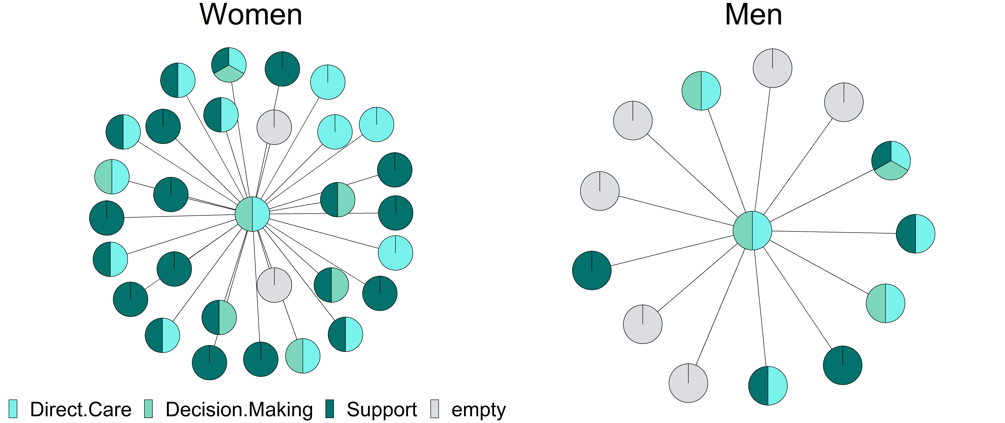
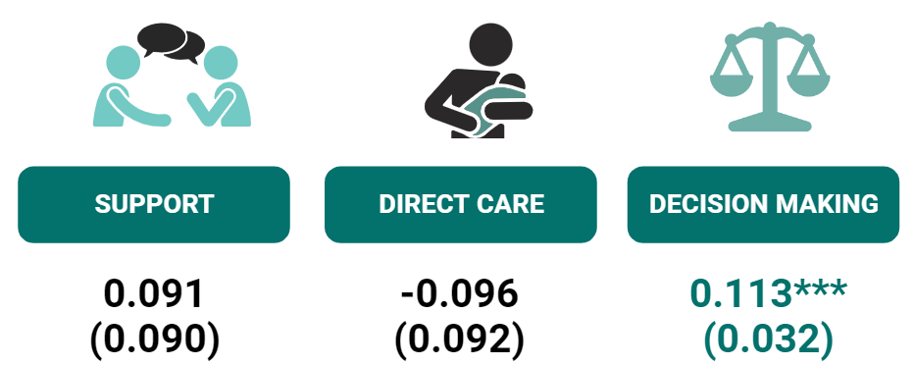
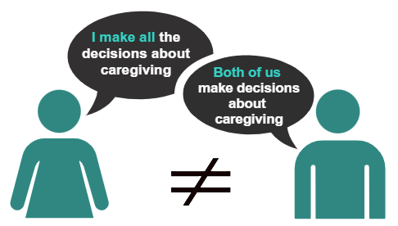


Gender Differences in Division of Labor and Network Utilization in Rare Disease Caregivers
Helen Wang, Patricia Cooper, Julia Nummelin, and Laura M. Koehly
Social Network Methods Section, Social Behavioral Research Branch, NHGRI
INTRODUCTION
RESULTS
60% of informal caregivers identify as women
Elevated caregiving burden and depression
Gender differences in time spent caregiving and use of network
Similar health outcomes for rare disease caregivers
Women have Larger Networks; No Significant Differences In Network Utilization
AIMS
Assess for gender differences in:
Network Utilization
Participation in Caregiving Activities
Examine
Perception of partner’s involvement in caregiving
Impact of dis/agreement on mental wellbeing
Women Are More Likely to Participate in Decision Making
Disagreement about Decision Making; Not Significantly Linked to Depression
METHODS
45 Caregiving dyads caring for children with rare and undiagnosed diseases
Regression with Sandwich Estimator
DISCUSSION
FUTURE DIRECTIONS
Women typically have larger networks
No gender differences in network utilization
Women report greater involvement in decision making than men
Disagreements about men’s involvement in decision making
Lack of consensus not associated with depressive symptoms
Sample is exclusive to heterosexual couples
Limited Demographic variability
Clarify disagreements about decision making (Medical, Daily, etc. Decisions)
Examine gender differences in type of support elicit from network
ACKNOWLEDGMENTS
This research is supported by the intramural research program at NHGRI (ZIAHG200395 to L.M.K). Thank you, SNMS!
Notes:
68% - support, 54% - direct care, 30% - decision making

